Slide 1
Machine Vision
MCTE 4323
Dr. Hasan Firdaus Bin Mohd Zaki
Lecture 4: Edge Detection & Hough Transform

Slide 2
Recap…(last week)
Properties of an image
Image histogram
Filtering/Smoothing/Removing Noise
Convolution/Correlation
Image Derivatives

Slide 3
Lets learn together!
what are edges
Sobel operator for gradient extraction
Canny edge detection algorithm
Hough transform
Hough transform for line and circle detection

Slide 4
Edges in Images: What are the significance?
There is strong evidence that some form of data compression occurs at an early stage in the human visual system
Research suggests that one form of this compression involves finding edges and other information - features in images
From edges we can construct a line drawing of the scene. This results in a huge data compression, but the information content remains very high
When we look at a sketch of a scene we do not feel that we are missing a great deal of information

Slide 5


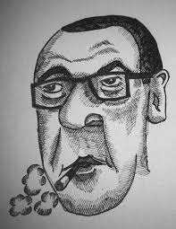
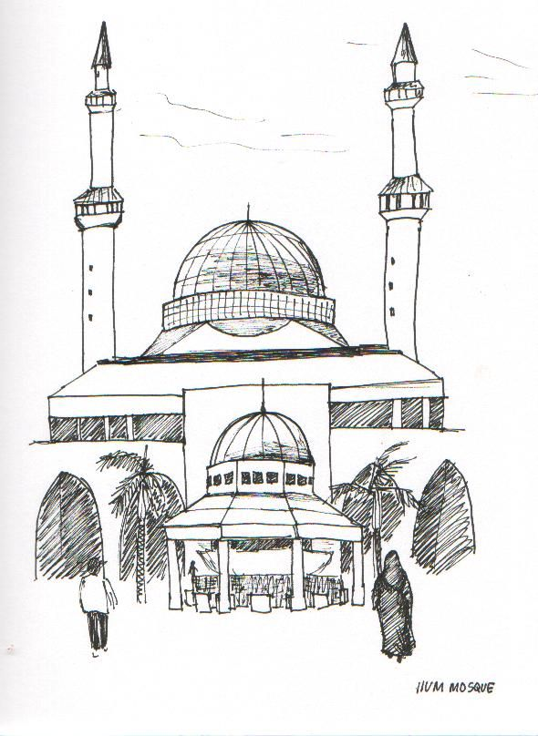
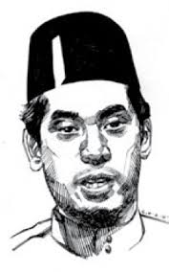
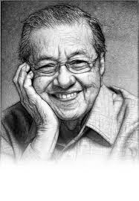
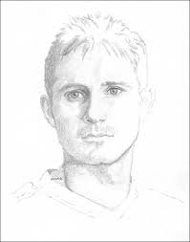
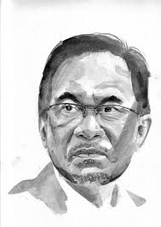
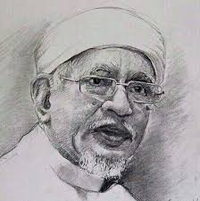

Slide 6
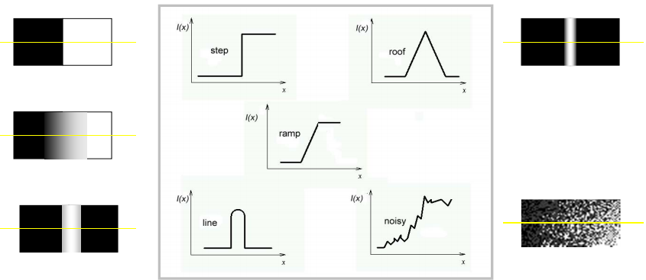
What is an edge?
Edge is a boundary between two regions with relatively distinct gray level properties.
Edges are pixels where the brightness function changes abruptly.

Slide 7
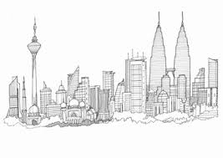
Edge Detection
Goal: Identify sudden changes (discontinuities) in an image
– Intuitively, most semantic and shape information from the image can be encoded in the edges
– More compact than pixels
Ideal: artist’s line drawing (but artist is also using object-level knowledge)

Slide 8
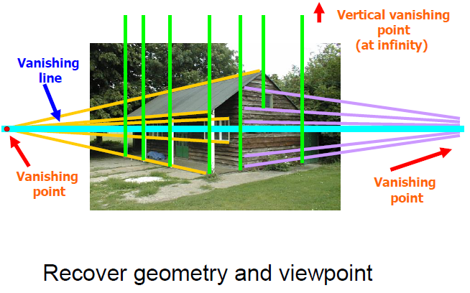
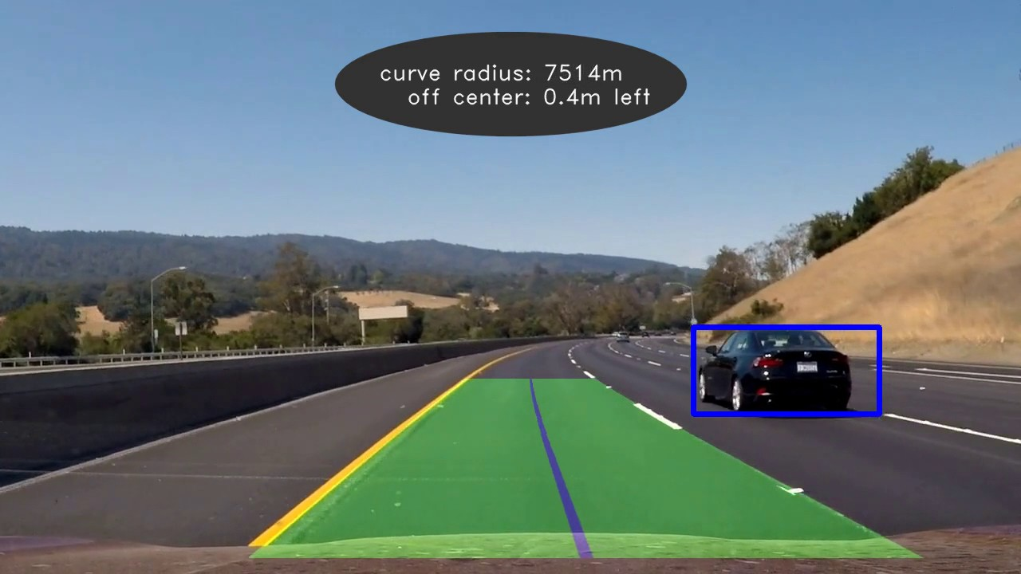
Why do we Care about Edges?
Extract information, recognize objects

Slide 9
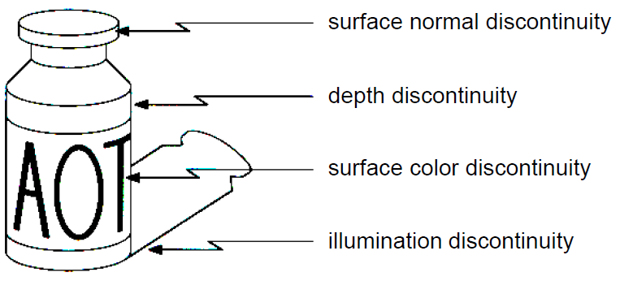
Edges are caused by a variety of factors

Slide 10
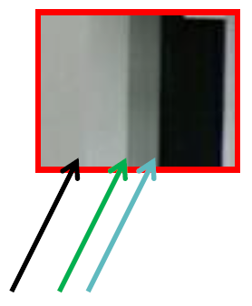

Slide 11
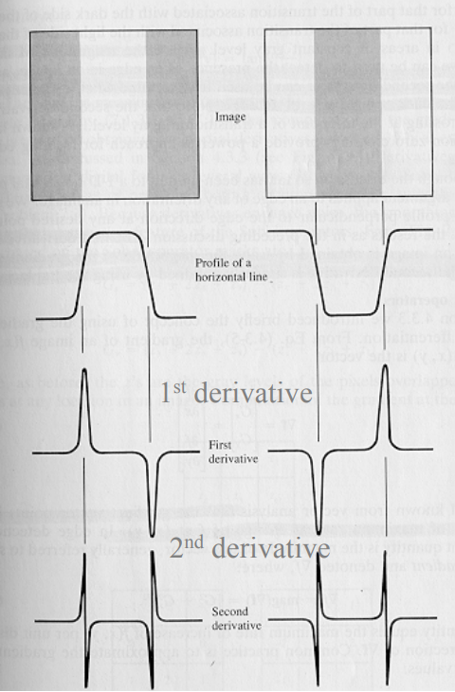
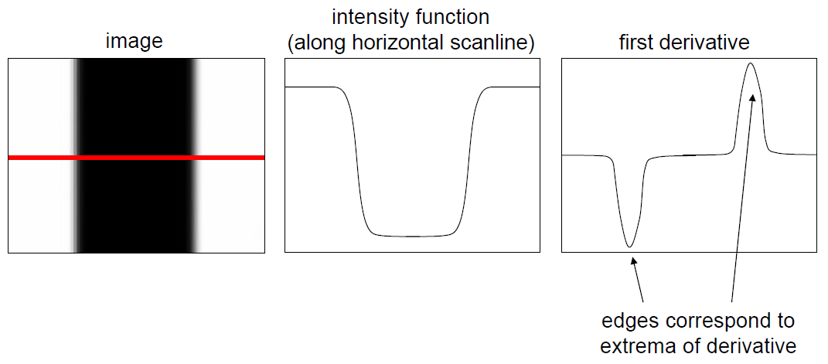
Edge Detection
Edge detection: a task of finding:
local maxima in the first derivative or
zero-crossing of the 2nd derivative

Slide 12
Characterizing Edges
In a discrete image, we calculate the gradient by taking the difference of grey values between adjacent pixels
Forward difference: 𝑔(𝑥) = 𝑓(𝑥 + 1) − 𝑓(𝑥)
Backward difference: 𝑔(𝑥) = 𝑓(𝑥) − 𝑓(𝑥 − 1)
Central difference: 𝑔(𝑥) = (𝑓(𝑥 + 1) − 𝑓(𝑥 − 1)) /2

Slide 13
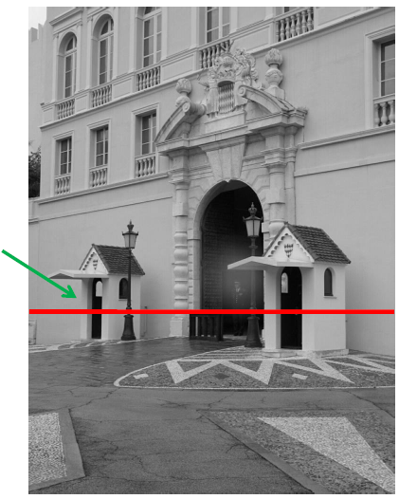
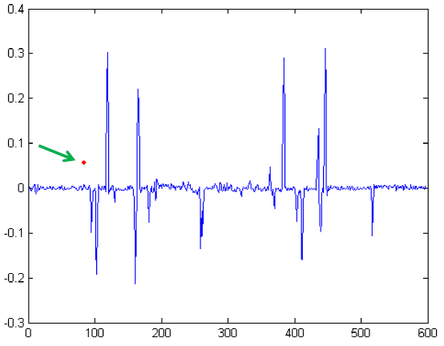
Intensity Profile
Grey level difference along horizontal line

Slide 14
First Derivative Edge Operators

Slide 15
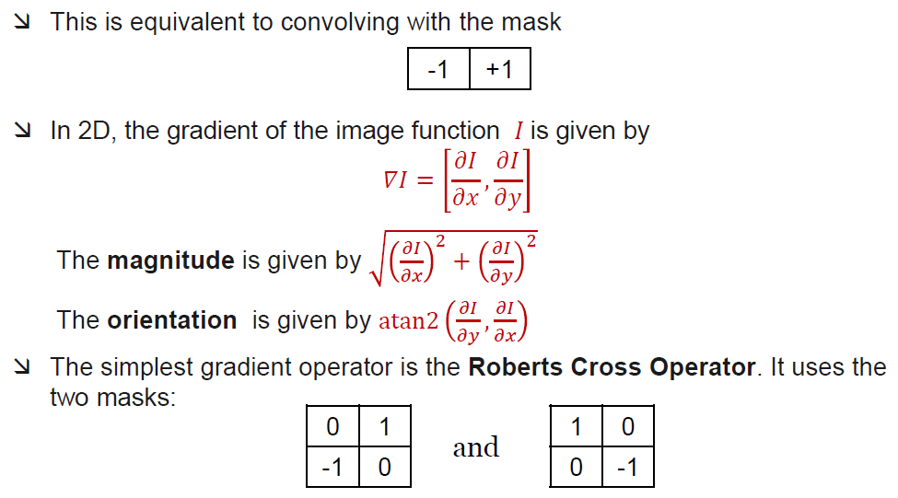
First derivative edge operator

Slide 16
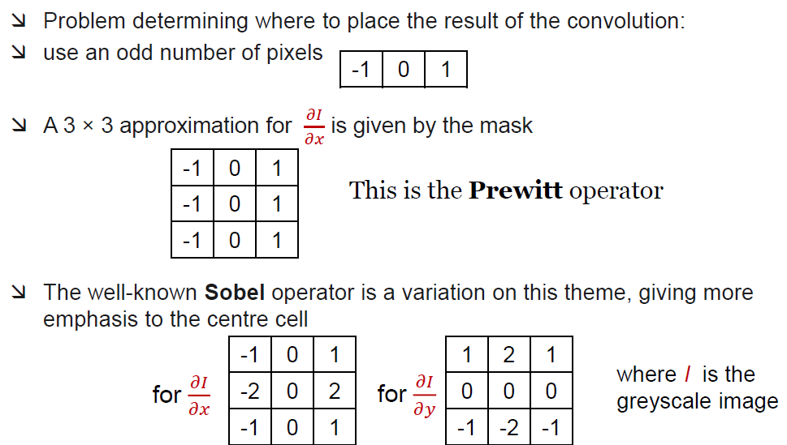
First derivative edge operator (con’t)

Slide 17
Prewitt and Sobel Edge Detector
Compute derivatives in x and y directions
Find gradient magnitude
Threshold gradient magnitude

Slide 18
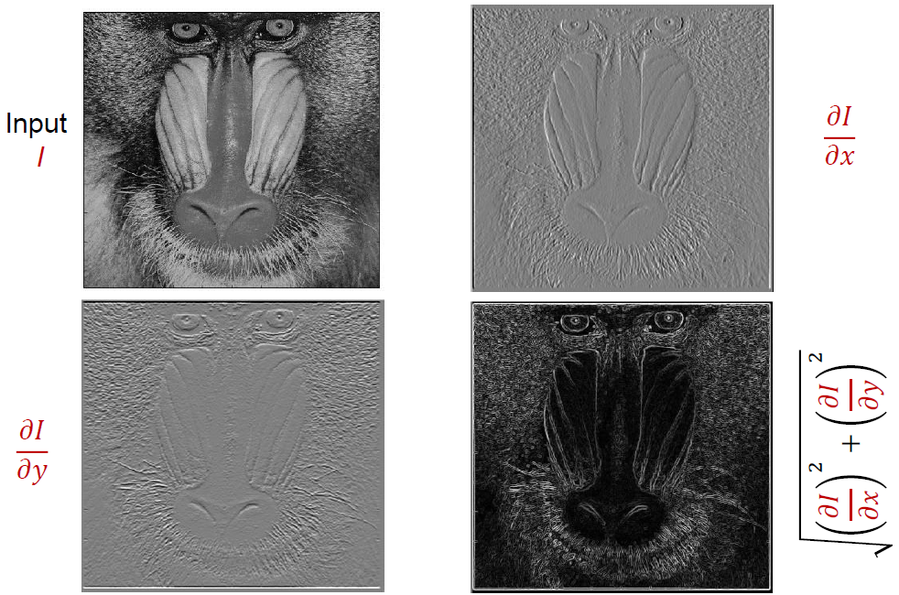
First derivative edge operator (con’t)

Slide 19
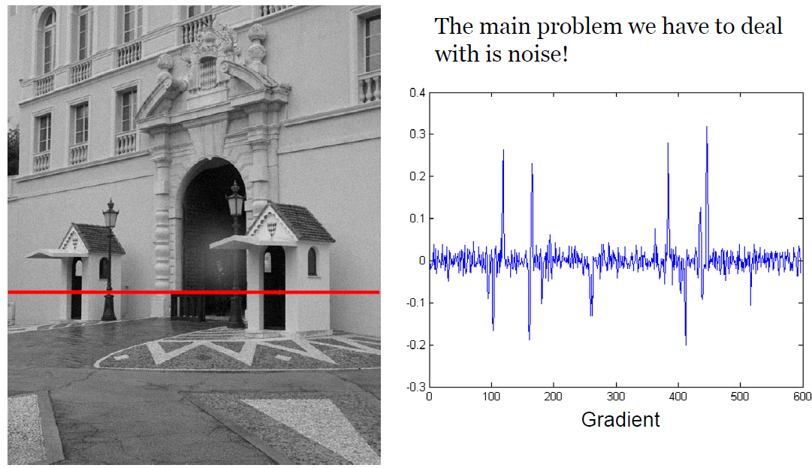

Slide 20
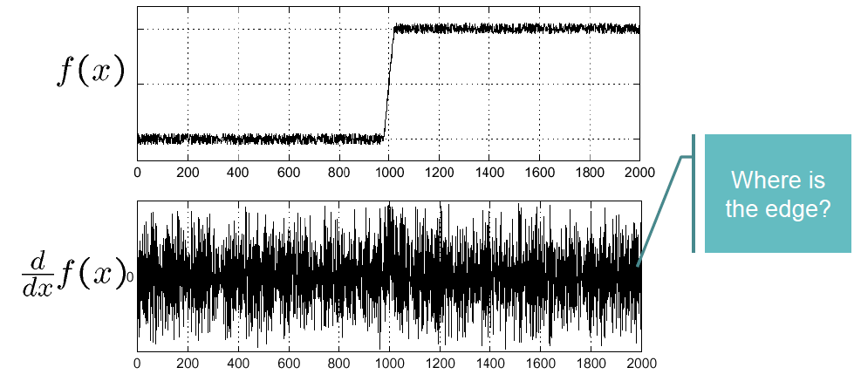
Effect of Noise
Consider a single row or column of the image
  Plotting intensity as a function of position gives a signal

Slide 21
Effect of Noise
Difference filters respond strongly to noise
  Image noise results in pixels that look very different from their neighbors
  Generally, the larger the noise the stronger the response
What can we do about it?

Slide 22
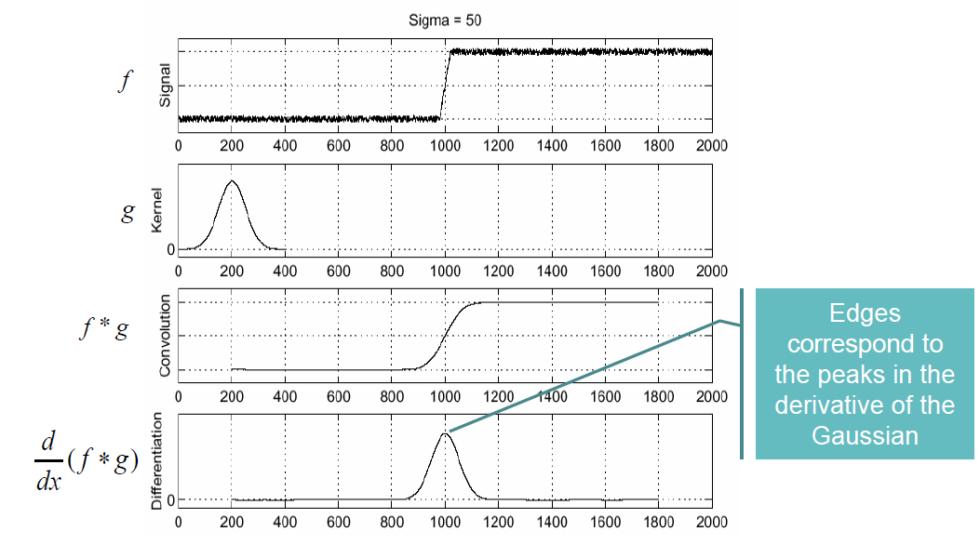

Slide 23
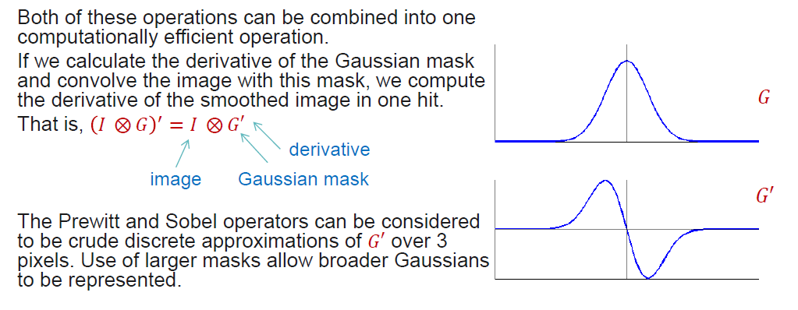
Solution: Smoothen First
1) Convolve the image with a Gaussian mask to smooth it
2) Calculate derivatives of the smoothed image

Slide 24
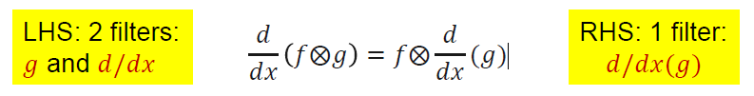
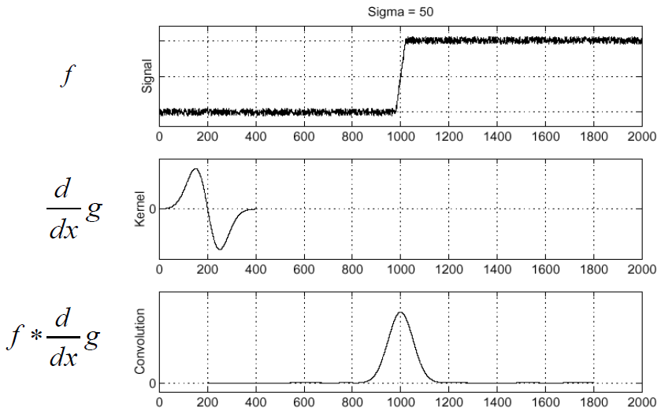
Derivative Theorem of Convolution
Differentiation is convolution, and convolution is associative.
This saves us one operation!

Slide 25
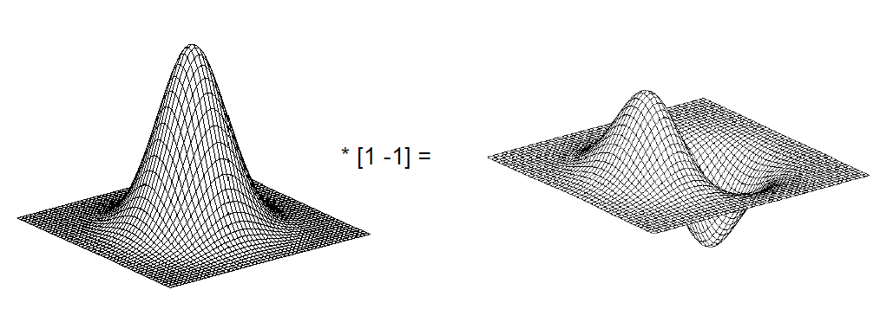
Derivative of a Gaussian Filter

Slide 26
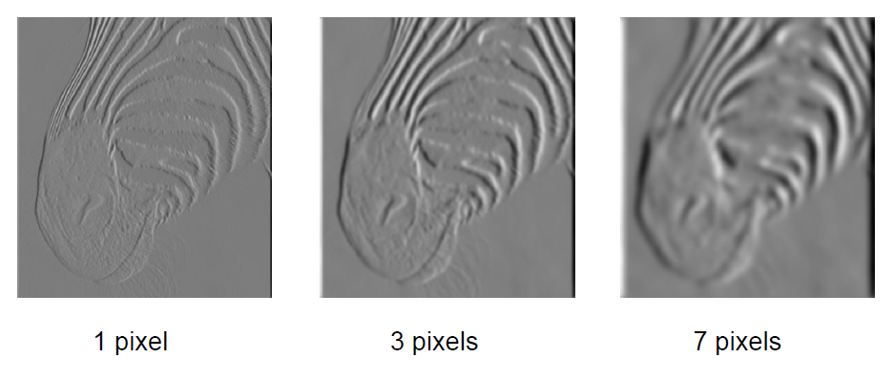
Tradeoff between Smoothing and Localization
Smoothed derivative removes noise, but blurs edge. Also finds edges at different “scales”.

Slide 27
Second Derivative Edge Operators

Slide 28
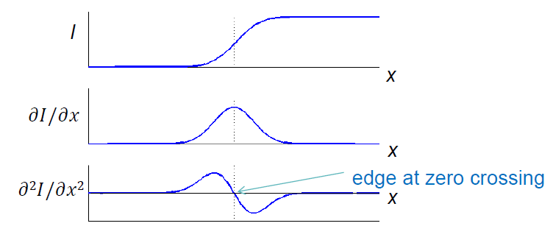

Second Derivative Edge Operators
To get horizontal and vertical edges we look at 2nd derivative in both x and y directions. This is the Laplacian of I :

Slide 29
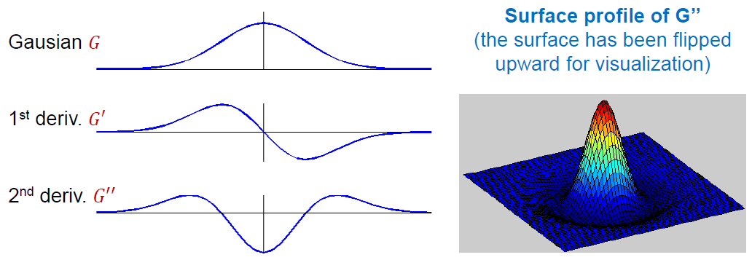
Second Derivative Edge Operators (cont.)
The Laplacian is linear and rotationally symmetric
Again we need to consider about smoothing the image with a Gaussian filter. It is well known that 𝛻² (𝐺 ⊗ 𝐼) = 𝛻²𝐺 ⊗ 𝐼
𝛻²𝐺 is known as the Laplacian of the Gaussian (LoG) operator

Slide 30
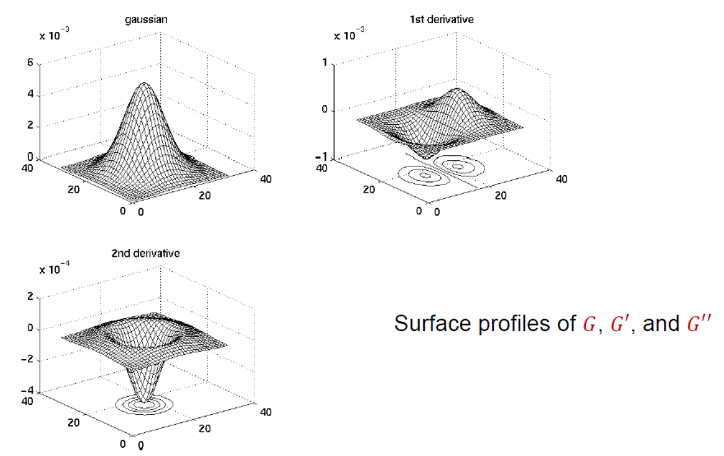
Second Derivative Edge Operators (cont.)

Slide 31
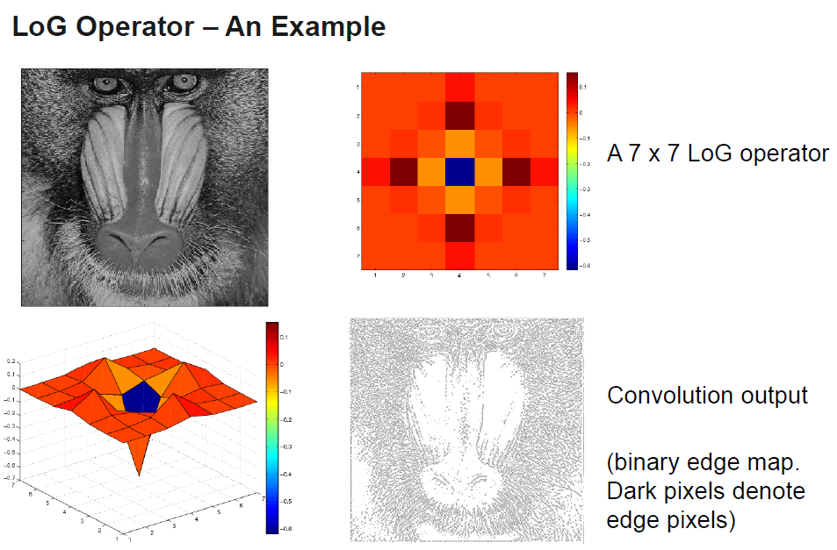
LoG Operator – An Example

Slide 32
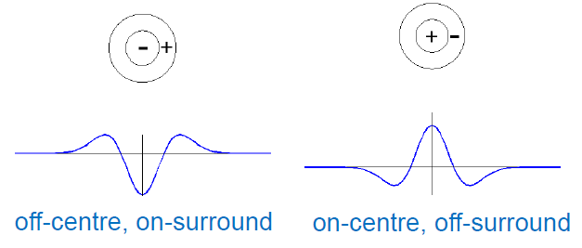
Second Derivative Edge Operators (cont.)
This operator became widely used, because…
Researchers found receptive fields in animals that behaved like this operator
The operator was symmetric – you find edges in all orientations
Zero crossings of the 2nd derivative always form closed contours

Slide 33
However…
However there are some problems:
  Being a 2nd derivative operator, the influence of noise is considerable
  There are many other types of receptive fields in the eye, so this is not the whole story
  Always generating closed contours is not realistic
  It will mark edges at some locations which are not edges (false positive)

Slide 34
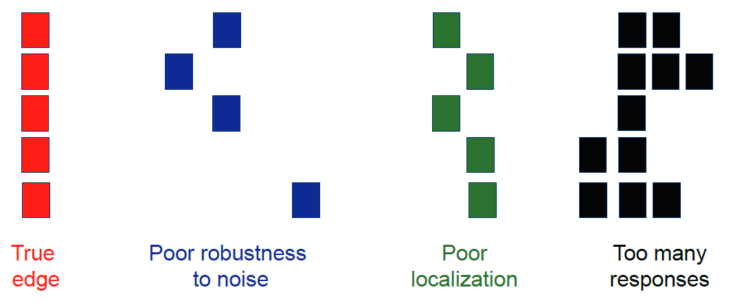
Designing an Edge Detector
Criteria for a good edge detector:
Good detection: the optimal detector should find all real edges, ignoring noise or other artifacts
Good localization
the edges detected must be as close as possible to the true edges
the detector must return one point only for each true edge point

Slide 35
The Canny Edge Detector
This is the current ‘standard’ and is used widely
Devised by John Canny as part of his Masters thesis at MIT in 1983
He treated edge detection as an optimization problem – maximize the detection of step edges in the presence of noise. The optimization criteria are:
  Good Detection- The optimal detector must minimize the probability of false positives as well as false negatives.
  Good Localization- The edges detected must be as close as possible to the true edges.
  Single Response Constraint- The detector must return one point only for each edge point.

Slide 36
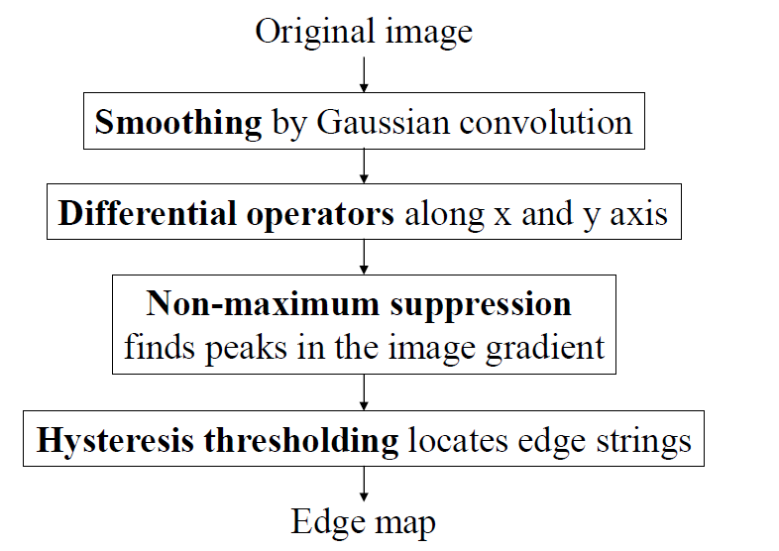
The Canny Edge Detector

Slide 37
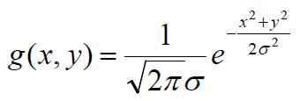

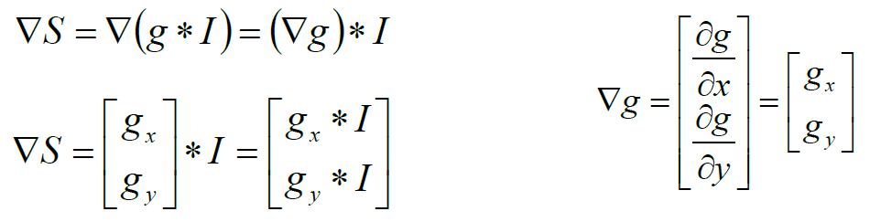
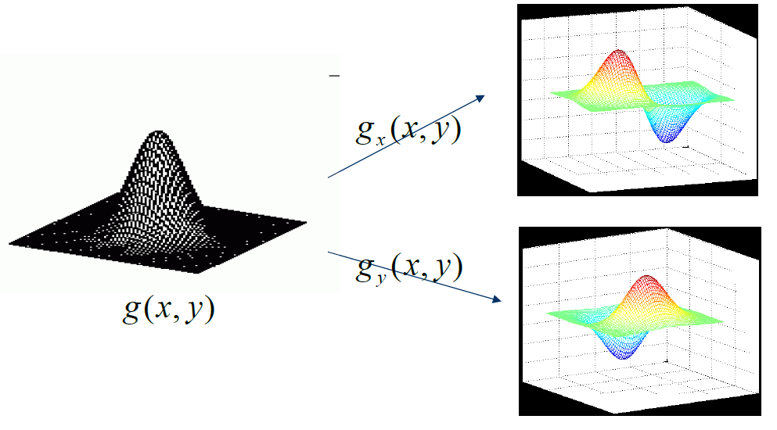
The Canny Edge Detector
1st step: Smoothing
2nd step: Derivative

Slide 38
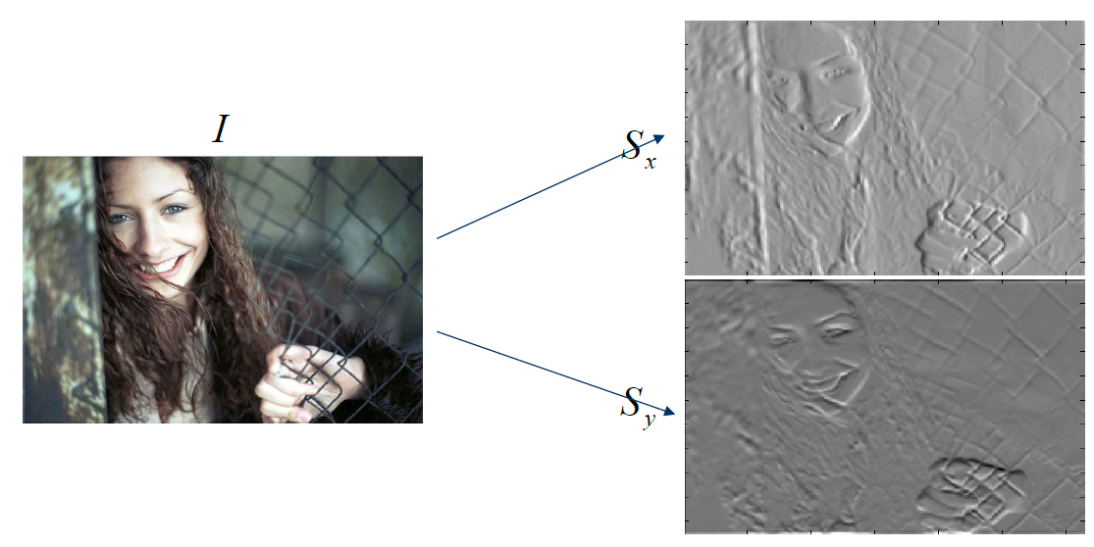
The Canny Edge Detector

Slide 39
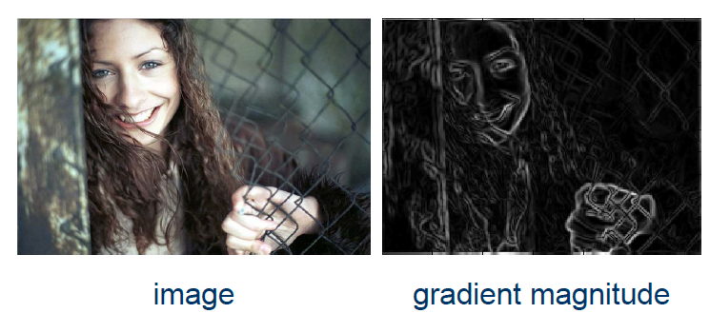
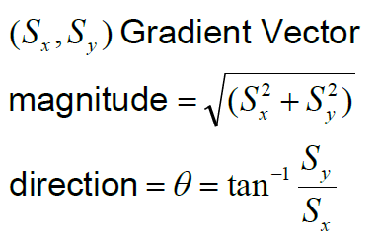
The Canny Edge Detector
Gradient magnitude and direction

Slide 40
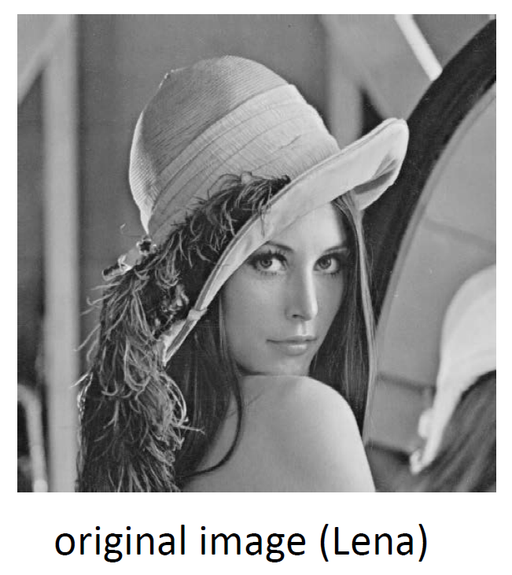
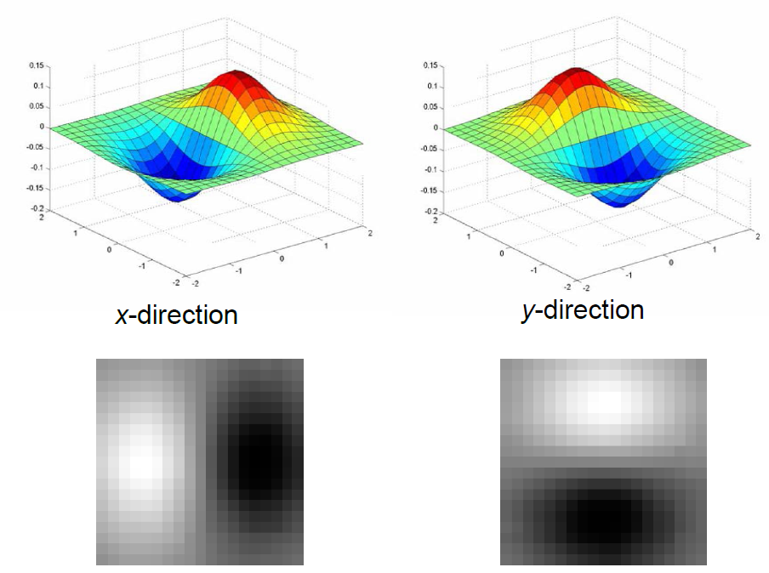
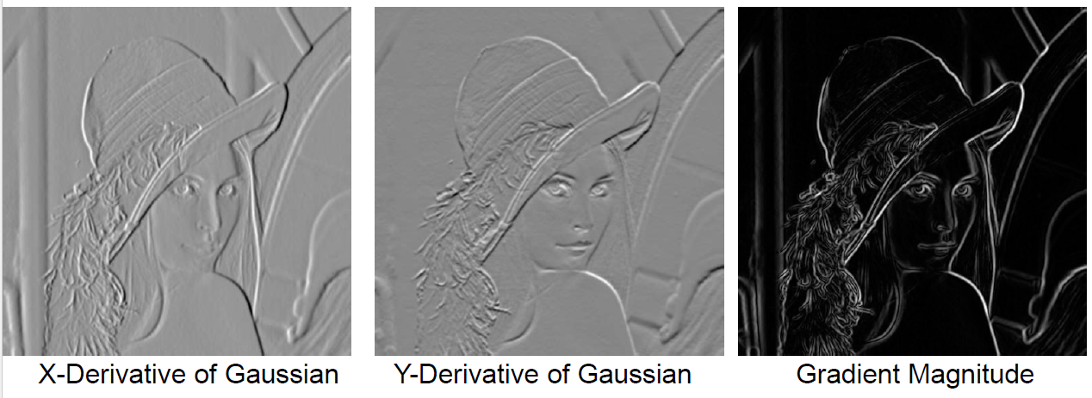
Another example

Slide 41
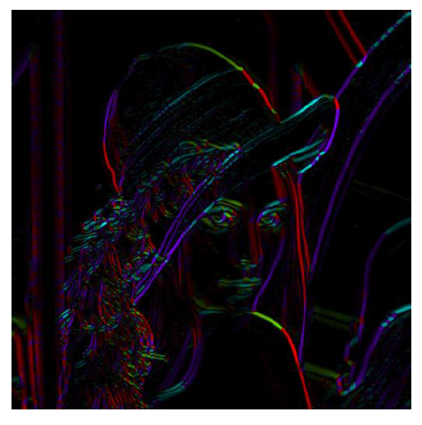
Get Orientation at Each Pixel
Threshold at minimum level
Get orientation
theta = atan2(gy, gx)

Slide 42
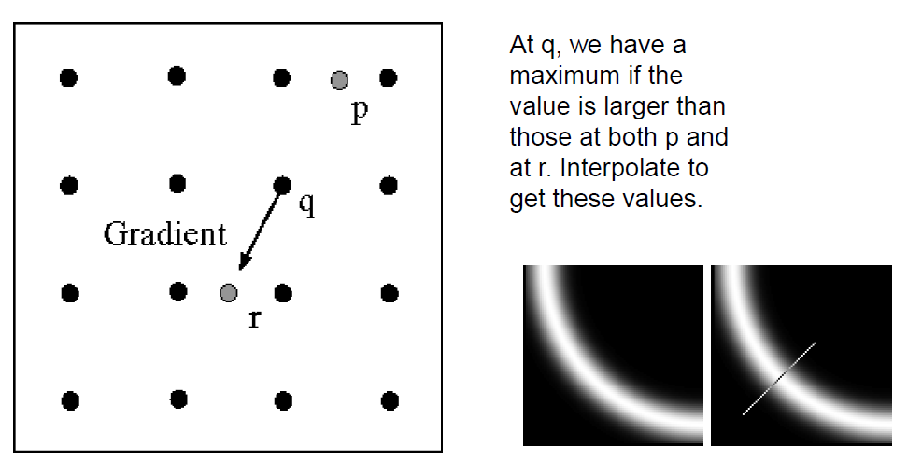
3rd step: Non-maximum Suppression for Each Orientation

Slide 43
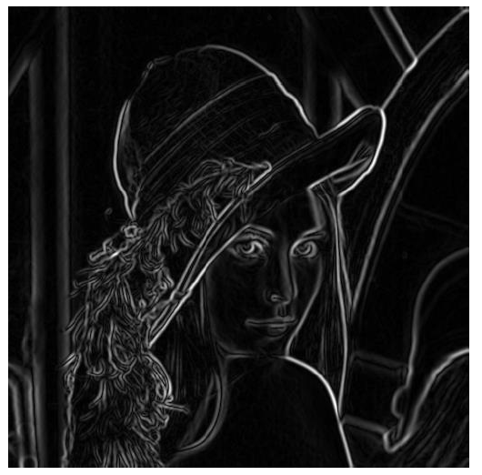
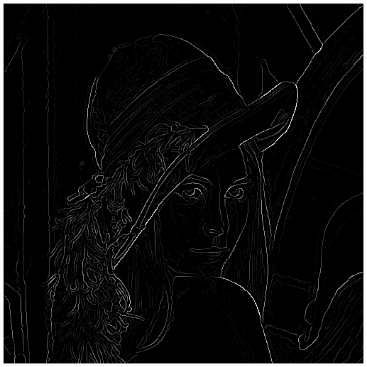
Non-maximum suppression
before
after

Slide 44
4th step: Hysteresis thresholding
If the gradient magnitude value at a pixel is above “High”
  declare it as an ‘edge pixel’
below “Low”
  declare it as a “non-edge-pixel”
between “low” and “high”
  Consider its neighbors iteratively then declare it an “edge pixel” if it is connected to an ‘edge pixel’ directly or via pixels between “low” and “high”.

Slide 45
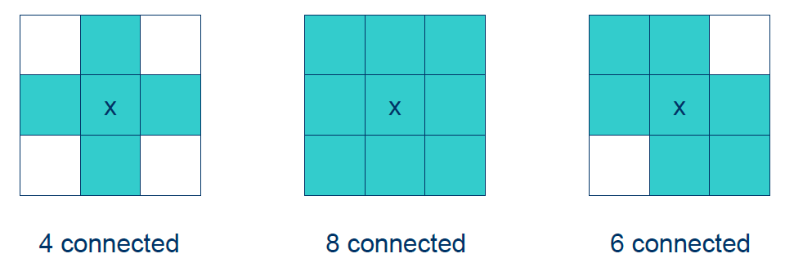
Hysteresis thresholding
Connectedness?

Slide 46
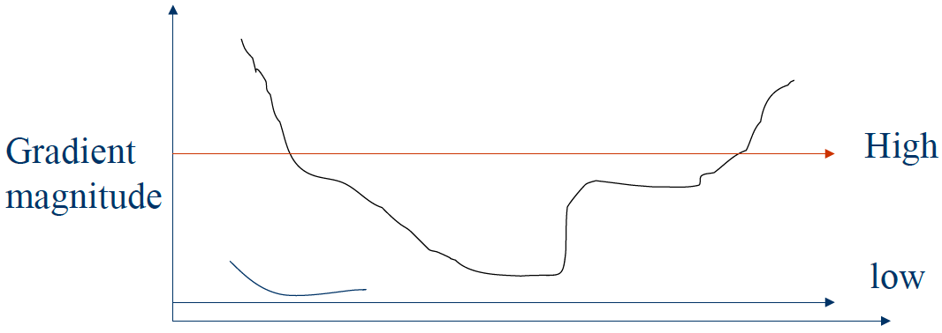
Hysteresis thresholding

Slide 47
Hysteresis thresholding
Scan the image from left to right, top-bottom.
  The gradient magnitude at a pixel is above a high threshold declare that as an edge point
  Then recursively consider the neighbors of this pixel.
    If the gradient magnitude is above the low threshold declare that as an edge pixel.

Slide 48

Hysteresis thresholding

Slide 49

Hysteresis thresholding
Threshold at low/high levels to get weak/strong edge pixels
Do connected components, starting from strong edge pixels

Slide 50

Final Canny Edges

Slide 51

Effect of σ (Gaussian kernel spread/size)
The choice of σ depends on desired behavior
  large σ detects large scale edges
  small σ detects fine features

Slide 52


Slide 53


Slide 54


Slide 55
Problems with Gradient Based Edge Detectors
You have to choose threshold values.
  If you double the size of an image leaving its grey values unchanged, all the gradient values will be halved…
You have to choose the amount of Gaussian smoothing (also known as the scale of analysis).
  This also affects gradients and hence the choice of threshold values. Also affects the perceived feature positions.
Corners are often missed because the 1D gradient at corners is usually small.
1st derivative operators will only find step-like features. There are many feature types, e.g. lines.
There are still new edge detection methods proposed today, but gradient based methods remain by far the most widely used ones.

Slide 56

Analyzing Edge Images
We have only found edge points
How can we find and describe more complex features (e.g. straight lines)?

Slide 57
Hough Transform
Each straight line in this image can be described by an equation
Each white point if considered in isolation could lie on an infinite number of straight lines
The idea of the Hough transform is that each point ‘votes’ for every line that could pass through it.
The equation of the line that gets most votes ‘wins’.

Slide 58


Hough Transform
Still remember?
Image and Parameter Spaces
3
2
1
3
2
1

Slide 59




Image and parameter space
variables
variables
parameters
parameters
a line becomes a point
Image space
Parameter space

Slide 60

Hough Transform

Slide 61
The flaw of Hough Transform?
The Hough transform described so far has an obvious flaw. Can you think what is the major flaw?
Hint: vertical line

Slide 62

Hough Transform

Slide 63

Hough Transform
In this representation, a line is formed using two parameters:
  ρ is the length of the normal from the origin (0, 0) onto the line
  θ is the angle this normal makes with the x axis.
The angle θ can be only from -90º to +90º and the length p can range from 0 to length of diagonal of the image. These values are finite, and thus you can "store" them on a computer without much trouble.
CREDIT: http://aishack.in/tutorials/hough-transform-normal/

Slide 64

Hough Transform

Slide 65

Hough Transform

Slide 66

Hough Transform

Slide 67


Image and parameter space
variables
parameters
parameters
variables
a point becomes?
Image space
Parameter space

Slide 68
Image and parameter space
variables
parameters
parameters
variables
a point becomes a wave
Image space
Parameter space

Slide 69
Image and parameter space
variables
parameters
a line
becomes?
Image space
Parameter space

Slide 70
Image and parameter space
variables
parameters
a line
becomes a point
Image space
Parameter space

Slide 71
Image and parameter space
variables
parameters
a line
becomes?
Image space
Parameter space

Slide 72
Image and parameter space
variables
parameters
a line
becomes a point
Image space
Parameter space

Slide 73
Image and parameter space
variables
parameters
a line
becomes a point
Image space
Parameter space

Slide 74


Image and parameter space
variables
parameters
two points become
?
Image space
Parameter space

Slide 75


Image and parameter space
variables
parameters
three points become
?
Image space
Parameter space

Slide 76


Image and parameter space
variables
parameters
four points become
?
Image space
Parameter space

Slide 77

Mechanics of the Hough transform

Slide 78

Hough Line Detection

Slide 79

Finding Circles by Hough Transform

Slide 80


Finding Circles by Hough Transform

